Slide 1

Synergy Online –Technical Interview Process
Divyashree HA
Campus Operations Executive
Notes:
The below and following notes on the template slides are to guide you only. In your final presentation, you may delete these notes and add relevant notes if any.
Title slide:
Title – should not exceed beyond 3 lines, font size 30-34, Arial Headings
(Font size for the title of the PPT can vary between 30-34, Arial Headings, Bold depending on the amount of text, however should not be smaller than 30 font size)
Name should not exceed beyond 1 line, Designation; font size to remain at 18, Arial Headings
Please keep the title slide simple, just the logo, title and name and designation to appear. No other graphic elements or any design, photograph, image can be added to this slide, alignment to remain the same

Slide 2
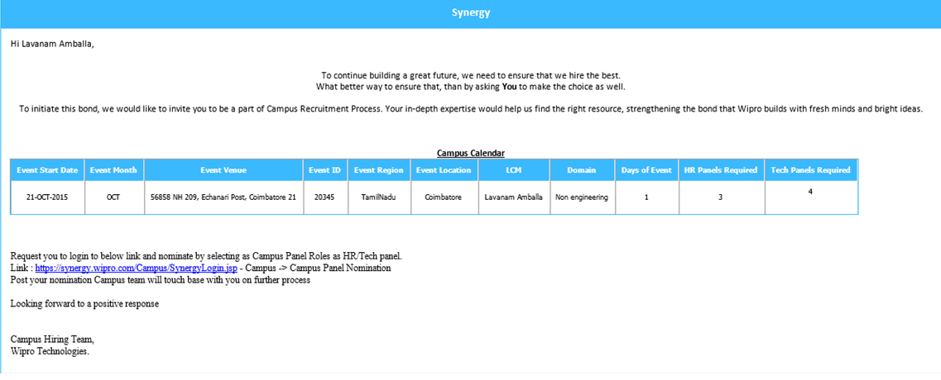
Auto Generated Email to the Panel for Nomination

Slide 3
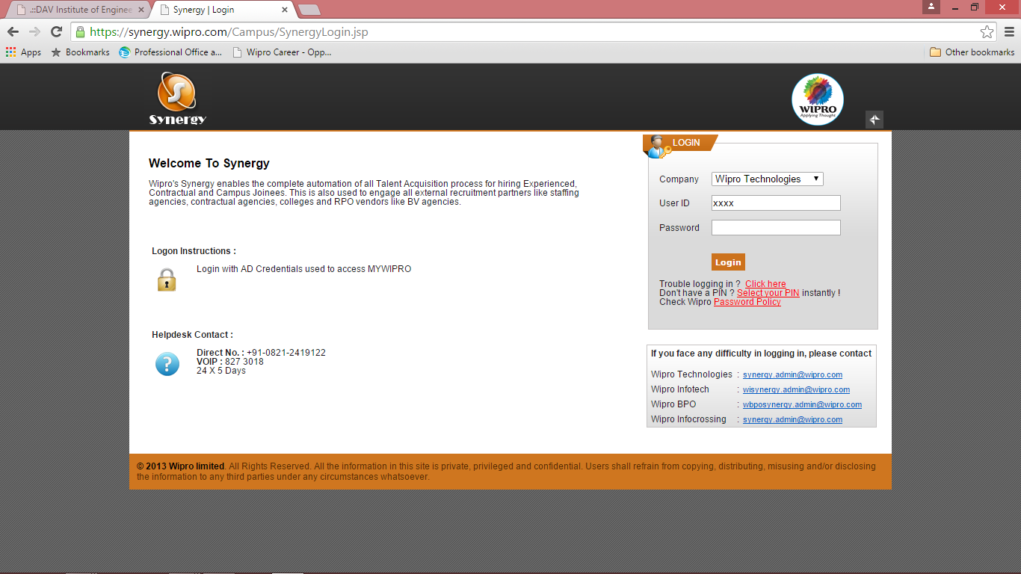
Tech Panel - >Login Details
Link: https://synergy.wipro.com/Campus/SynergyLogin.jsp
You might be having other Synergy links, please use only the above one
Select only Wipro Technologies In Company dropdown

Slide 4
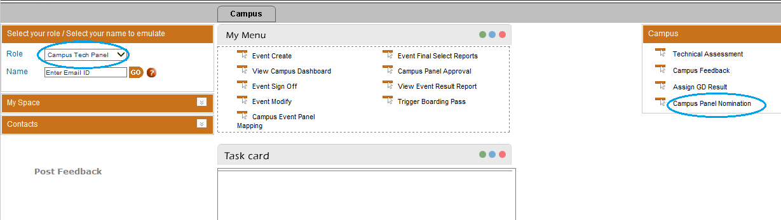
Step – 1 Panel Nomination Acceptance

Slide 5
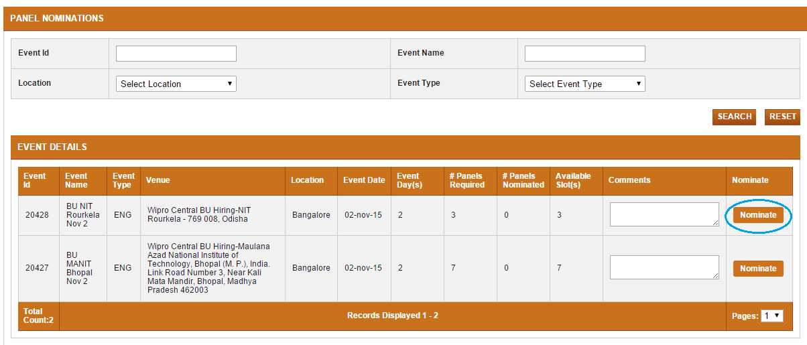
Step 2 -> Tech Panel Nomination Acceptance

Slide 6
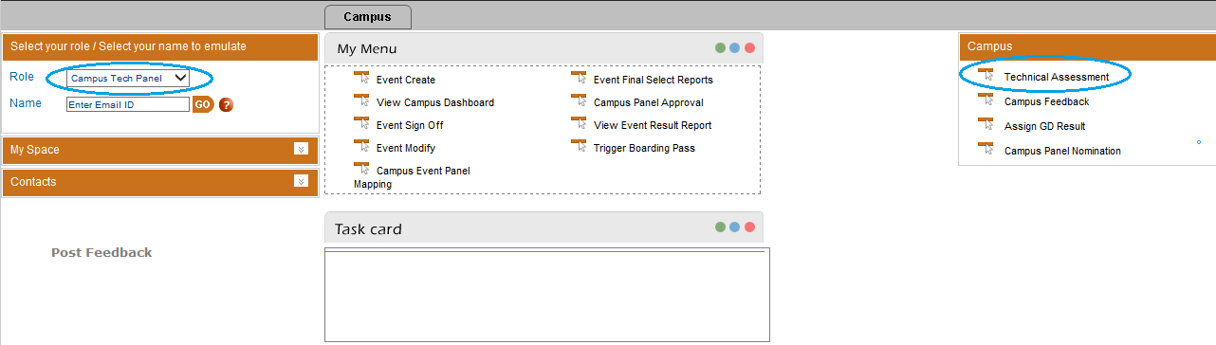
Step 3

Slide 7
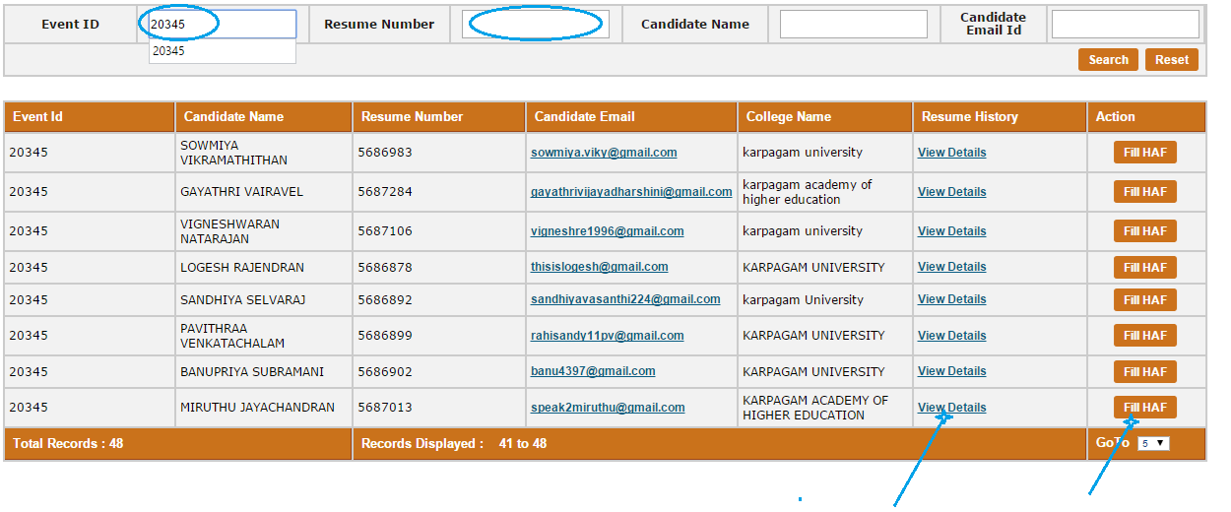
Step - 4
Technical assessment forms >>Enter Event ID & Resume No
View Resume History & Start Filling the assessment

Slide 8
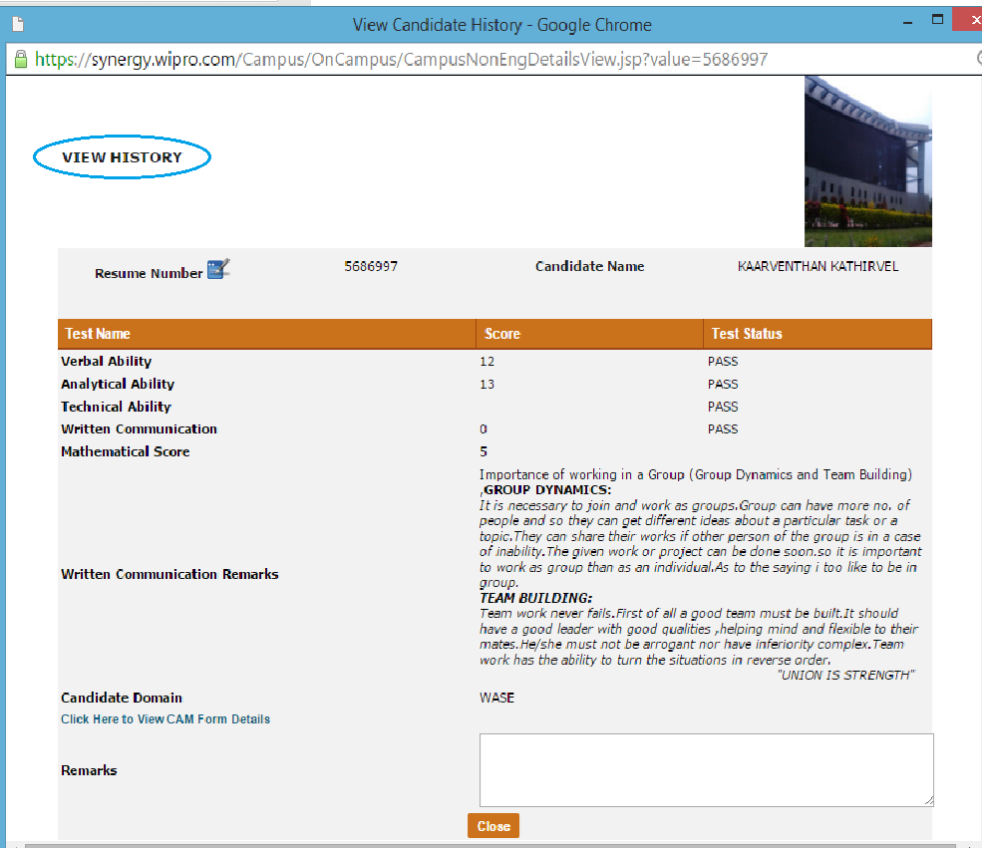
Step - 5

Slide 9
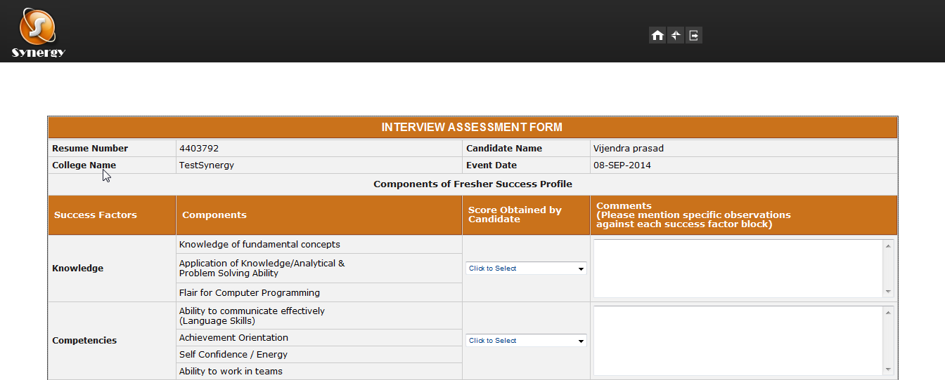
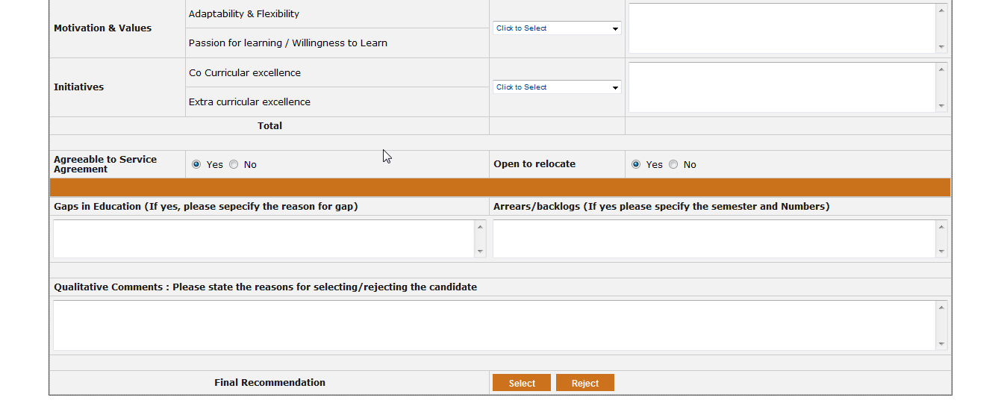
Technical Assessment Form All line items are mandatory
Step - 6

Slide 10
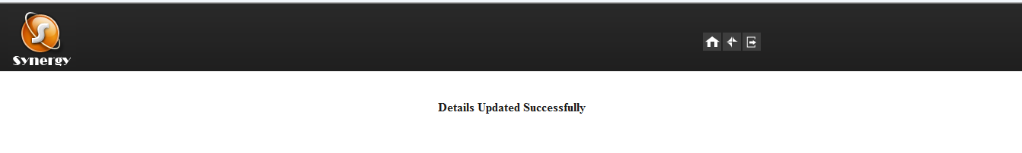

Slide 11
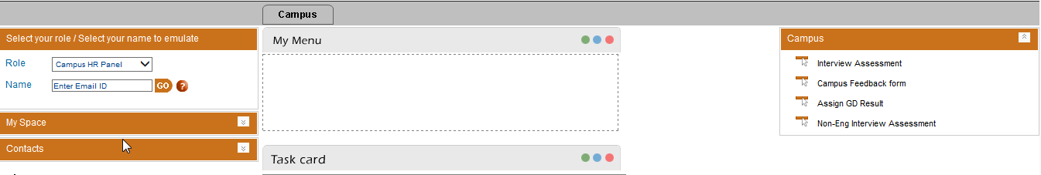
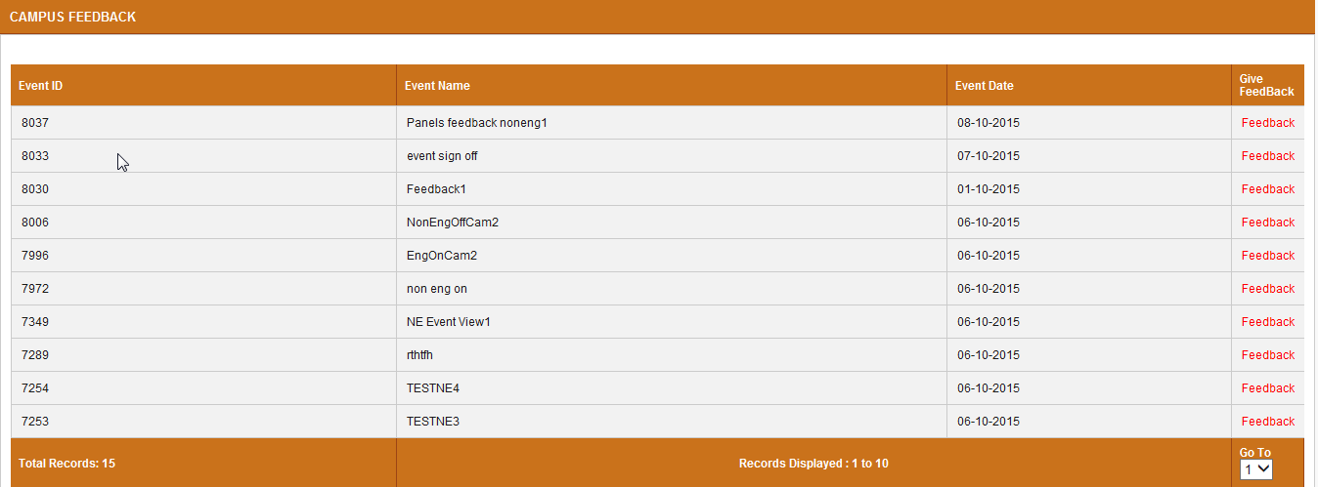
Panel Feedback Form
Menu link : Campus Feedback form
New

Slide 12
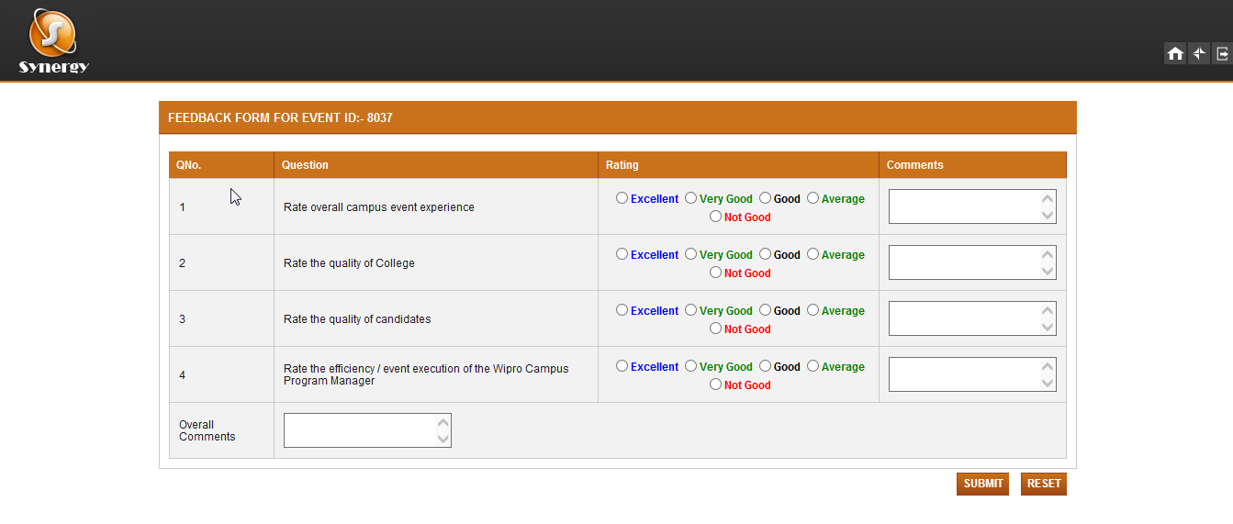
Panel Feedback Form
New

Slide 13
Notes:
Thank you slide with customer logo
Thank you slide with the customer logo:
Should have only the details shown here. Logo placement cannot be changed. Wipro logo to appear on the left as per our corporate guidelines.
Thank you– font size 30, Arial Headings
Name & Designation – font size 18, Arial Headings, not to exceed beyond 2 lines
Your/contact email id – font size 18, Arial Headings

